Slide 1

Statistics Final Project: Hotel Dataset
Filippos Symeonidis

Slide 2

Context
The online hotel reservation channels have dramatically changed booking possibilities and customers’ behavior.
A significant number of hotel reservations are called-off due to cancellations or no-shows.
The typical reasons for cancellations include change of plans, scheduling conflicts, etc.

Slide 3
Research Question
How do different factors in the hotel booking process, such as the room type, lead time and price interact to affect the cancellation rate? In particular, how do these factors influence each other, and how can hotel managers optimize their pricing and marketing strategies to increase revenue and reduce cancellations?

Slide 4
Data
room_type: Type of room reserved by the customer.
lead_time: Number of days between the date of booking and the arrival date.
market_segment: Market segment designation.
price: Average price per day of the reservation; prices of the rooms are dynamic. (in euros)
booking_status: Flag indicating if the booking was canceled or not.
The data have been captured from single location/country which, due to discretionary reasons, could not be disclosed.

Slide 5
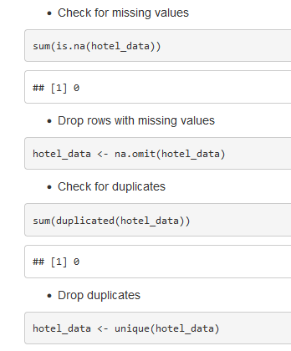
Exploratory Data Analysis
Data Cleaning:

Slide 6
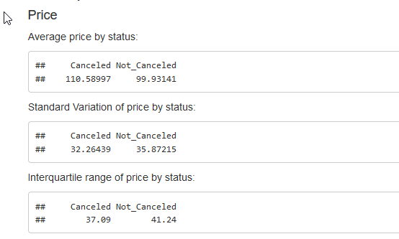
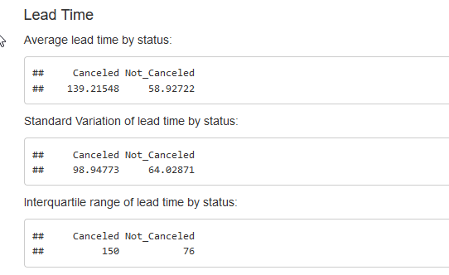
Descriptive Statistics:
Compute the mean and standard deviation for price and lead time
Create a table showcasing the market segment and room type data
Finally, we separate into new subsets all the room types and the booking status

Slide 7
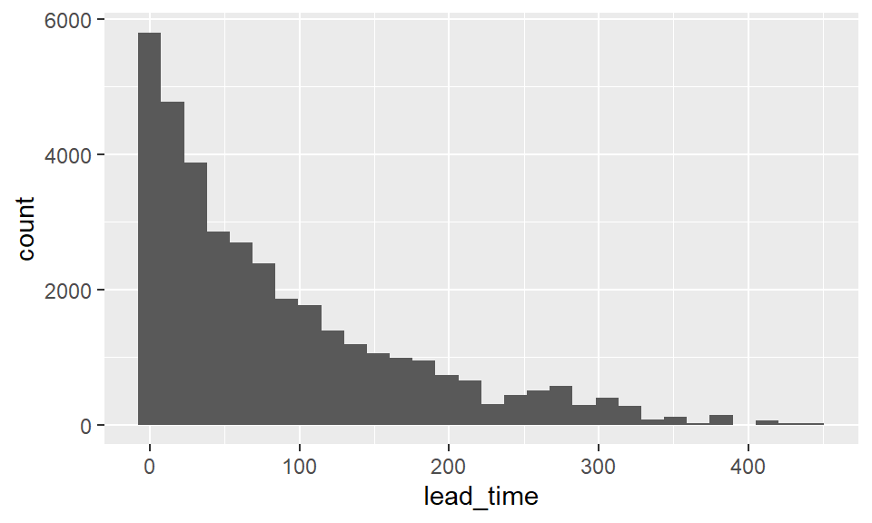
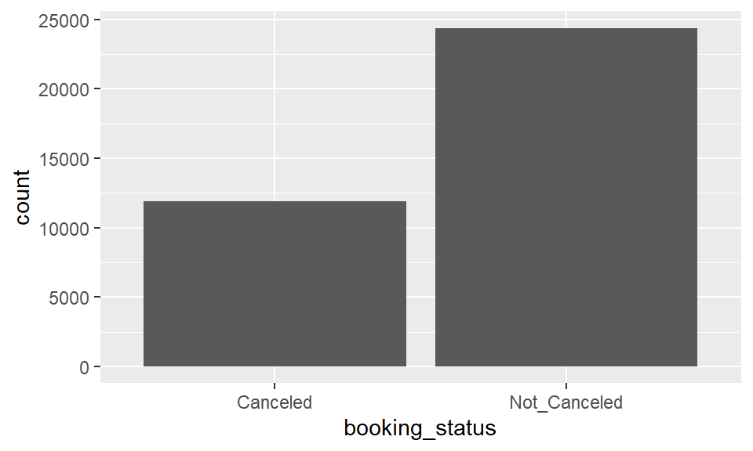
Visualization

Slide 8
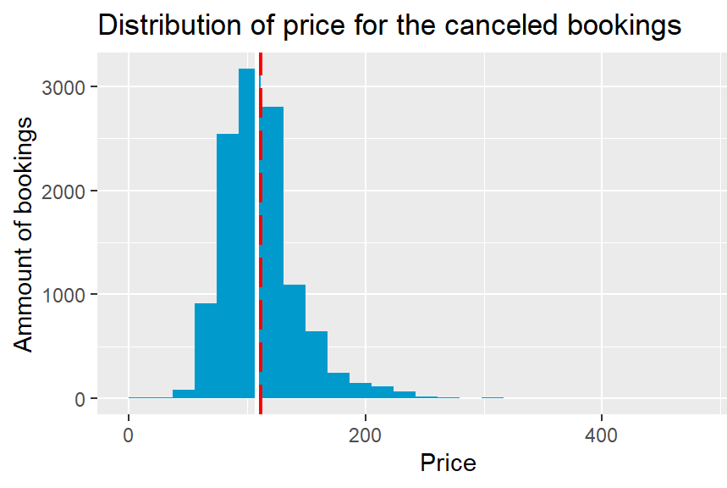
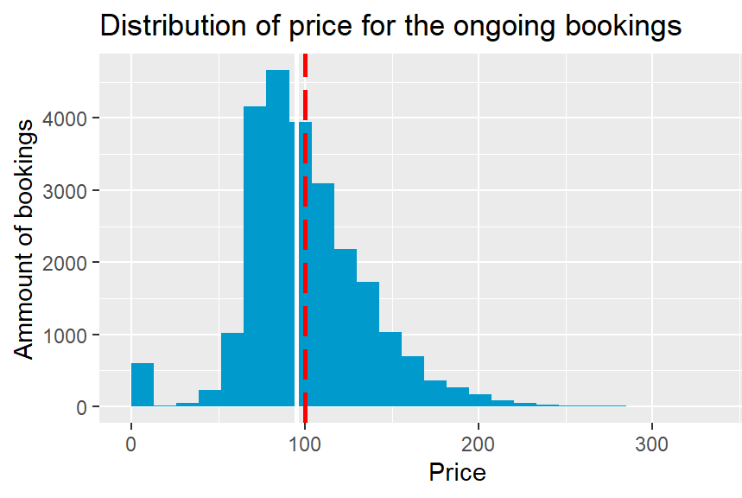

Slide 9
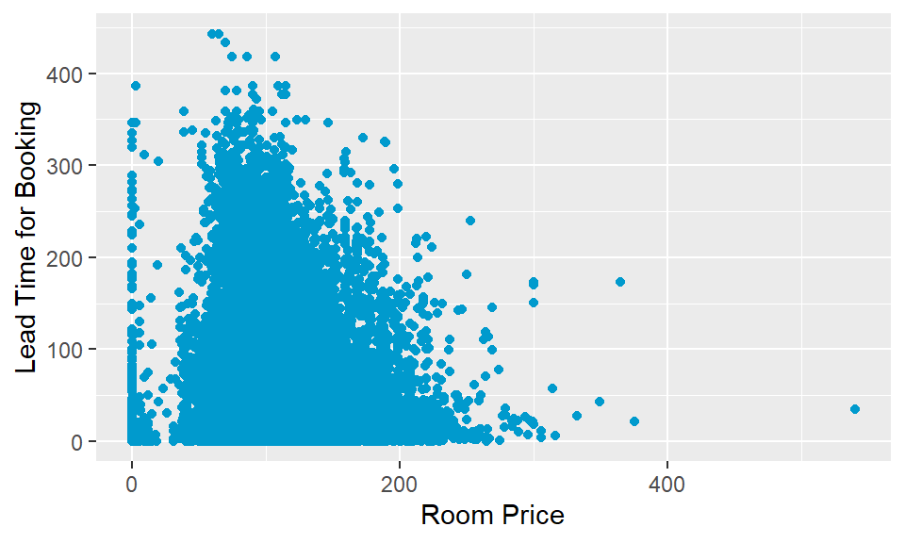
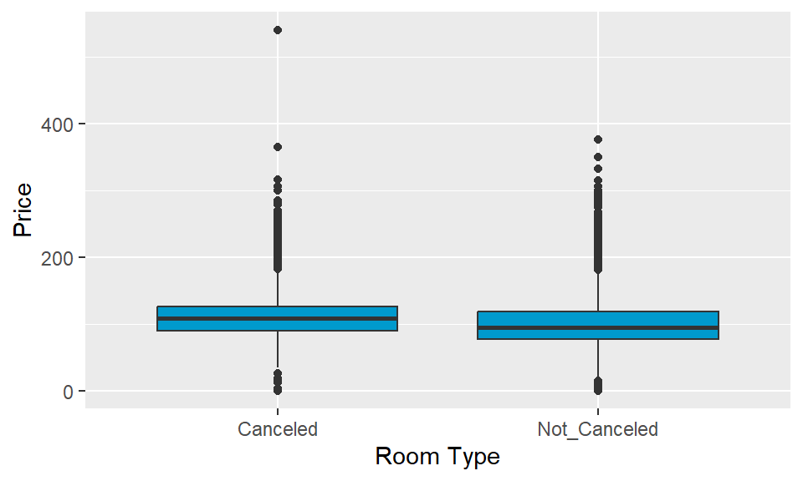

Slide 10

Hypothesis
Null Hypothesis: The cancellation of hotel bookings is not influenced by the interplay of various factors such as lead time, and price.
Alternative hypothesis: The cancellation of hotel bookings is influenced by the interplay of various factors such as lead time, and price.

Slide 11
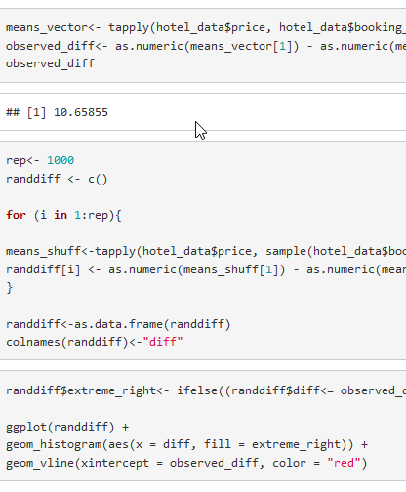
Statistical Inference
We will use a randomization test, specifically, a two-sample t-test.
The randomization test is used to simulate a null distribution by randomly shuffling the booking_status variable and calculating the mean price difference between the shuffled groups.
By generating many random samples, we can calculate a p-value.
This gives us the probability of observing a difference which will be less extreme or more extreme than the observed difference, assuming the null hypothesis is true.
If the p-value is very small, we reject the null hypothesis.

Slide 12
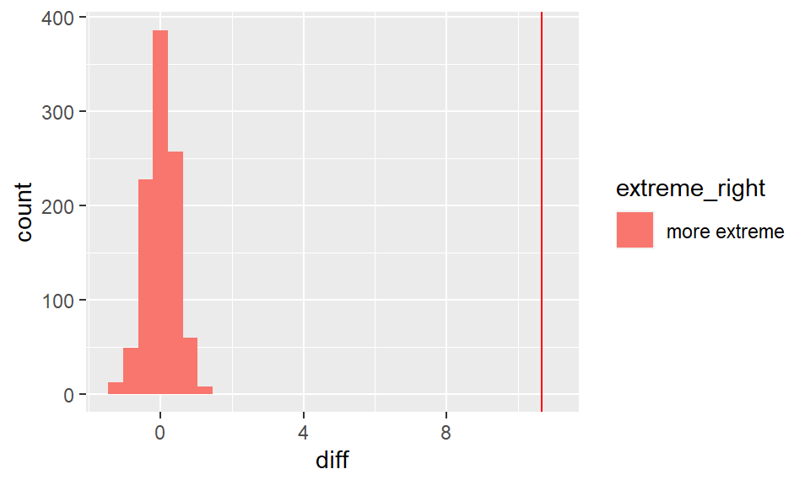
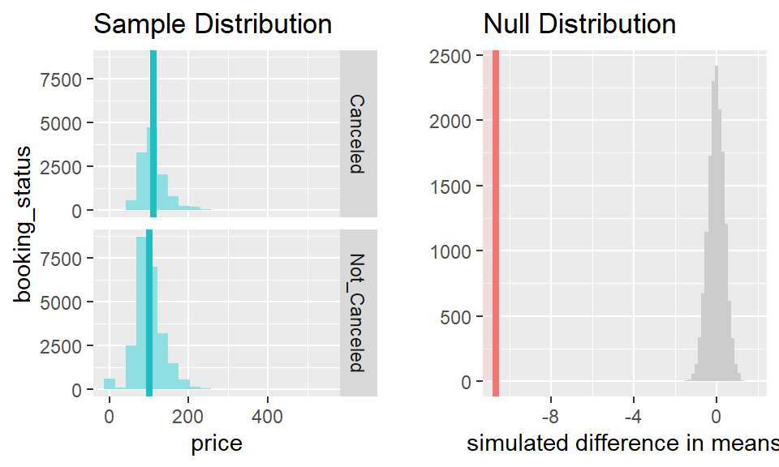
Results - Price
The mean price of hotel bookings that were canceled (110.59) is significantly higher than the mean price of bookings that were not canceled (99.9314).
The p-value is less than 0.0001, which means that we reject the null hypothesis (H0) that there is no difference in cancellation rates between the two groups.

Slide 13
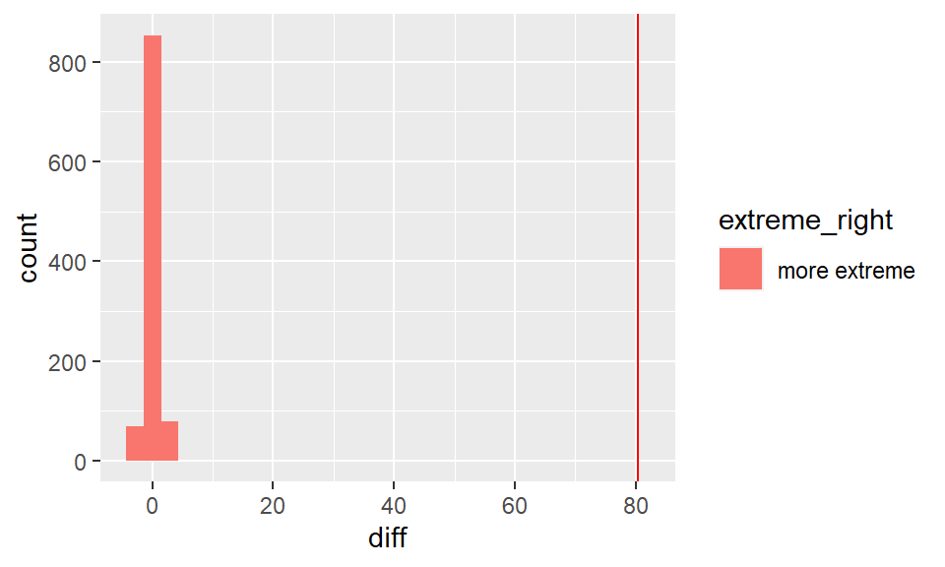
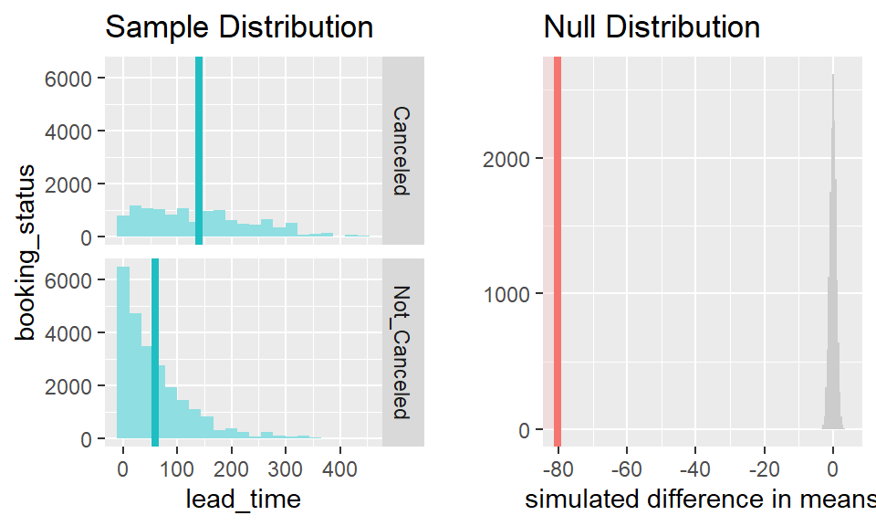
Results – Lead Time
The mean lead time of hotel bookings that were canceled (139.2155) is significantly higher than the mean lead time of bookings that were not canceled (58.9272).
The p-value is also less than 0.0001, which means that we reject H0 that there is no difference in cancellation rates between the two groups.

Slide 14
Conclusion
Overall, both scenarios agree and provide evidence that cancellation of hotel bookings is influenced by factors such as lead time and price.
Meaning that the alternative hypothesis (HA) that cancellation is influenced by the interplay of various factors such as lead time and price is supported.

